Slide 1
Fake News Detection using Ensemble approach
Group No. 20
Akansha Gautam (2016221)
Harshita Sahu (MT20087)
Khushboo Bajaj (MT20060)
Divya Pandey (MT20128)
Notes:
Good Afternoon. I’m Akansha, member of group number 20.
We’re here to present our work titled as Fake News Detection using Ensemble Approach. So let’s dive in!

Slide 2

Problem Statement
News consumption using online media has increased.
Encourages the spread of misinformation and hoaxes.
A recent research shows that public engagement with false information is higher than legitimate news.
Need a tool to automatically detect fake news articles
https://asia.nikkei.com/Spotlight/Asia-Insight/Asia-s-war-on-fake-news-raises-real-fears-for-free-speech
Notes:
[1 min] The first slide focuses on the Problem Statement. News consumption using online media has increased exponentially in modern society due to cheaper cost, easy accessibility, and rapid dissemination of information. However, it also encourages the spread of misinformation and hoaxes. If we will see the current situation, COVID-19 has affected our daily lives to much greater extent. Since the beginning of COVID-19 pandemic the distribution of false information ranges from false assertions to harmful health advices has negatively affected individuals and society. A recent research report of Science Daily Blog showed that public engagement with false news is higher than with legitimate news from mainstream sources that makes social media a powerful channel for propaganda. Therefore, there is a need to automatically detect fake news as it has become an important issue in this modern society.

Slide 3
Related Works
In [1], researchers developed two datasets and used linear SVM classifier to perform their experiments.
In [2],a recent study presented a new set of features along with the exploration of the existing ones.They have used several classic and state-of-the-art classifiers, including KNN, NB, RF.
In [3], another group of researchers proposed a model called CSI on which first module uses RNN and second is based on behaviour of users.
In [4], a recent study focuses on two variations of end to end deep neural architectures and the first model is based BiGRU and another is ELMO and the NLP network.
In [5],some prior studies used news content with additional information (social context information) to build a model to detect fake news.
In [6], a study used LIAR dataset. A model based on surface-level linguistic patterns. The baseline includes logistic regression, SVM, LSTM and a CNN model.

Slide 4
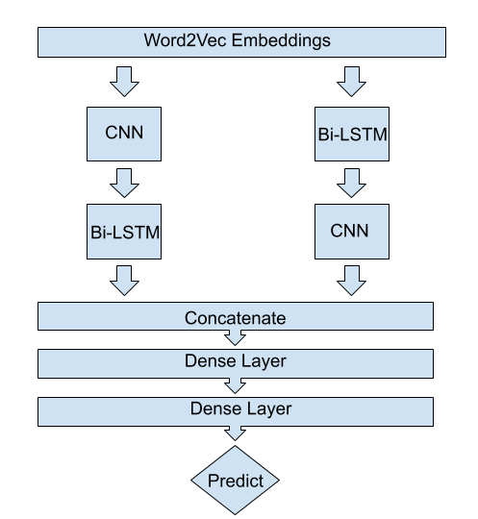
Methodology
Our experiment is conducted on merging different metadata (Text, title, and author)
Extract Word embeddings using Word2Vec model
Proposed method involves an ensemble stack-based approach comprising of two deep learning models:
CNN + Bi-LSTM
Bi-LSTM + CNN
Concatenation of the extracted features then fed to the following two dense layers to predict input text articles as fake or real
Various other layers are added to the proposed approach such as:
Max-pooling layer
Dropout layer
Batch-Normalization layer
Notes:
We performed our experiments on a combination of different metadata such as Text, title and author. So first of all we pre-processed our train and test data by lowercasing, removing stopwords, HTTPS links, punctuation, digits, and then we performed lemmatization. We use this preprocessed data to extract word embeddings using word2vec model. In this project, we propose a novel ensemble stack-based approach comprising of two deep learning models. The first stack consists of CNN + Bi-LSTM and then another one comprising of Bi-LSTM + CNN models. We provide an input of word embeddings to proposed model which extract features using two stacks and then the concatenation of these features take place to further pass it on two dense layer to classify fake and real news articles. Various other layers are also added to the proposed architecture such as max-pooling, dropout, and batch-normalization layer.

Slide 5
Intuition behind the proposed approach
CNN
Extract salient features invariant to their position within the input sequences
We used 100 filters with size 4 to extract features of words from article text
Bi-LSTM
Capture the previous context and the future context of the input sequence
CNN + Bi-LSTM
Convolution layer extract local features from input word embeddings.
Bi-LSTM layer will be able to use the ordering of said features to learn about the input’s text ordering.
Bi-LSTM + CNN
Bi-LSTM layer generates a new encoding for the original input word embeddings.
Output of the Bi-LSTM layer is then fed into a convolution layer to extract local features.
Other layers
Dropout and Batch Normalization Layer
avoid overfitting on the training data
Max-pooling Layer
downsample the output of the previous layer to allows only the valid information to pass
Notes:
This slide focuses on the intuition behind using this proposed architecture. We used CNN to extract salient features (e.g., tokens or sequences of tokens) invariant to their position within the input sequences and used 100 filters with size 4 to extract features of words from article text. Bi-SLTM is used to Capture the previous context and the future context of the input sequence. We use CNN + Bi-LSTM layer in such a way that Convolution layer extract local features from input word embeddings and then Bi-LSTM layer will be able to use the ordering of said features to learn about the input’s text ordering. The intuition behind using Bi-LSTM + CNN layer is that Bi-LSTM layer generates a new encoding for the original input word embeddings and output of the Bi-LSTM layer is then fed into a convolution layer to extract local features. As I already explained that we added other layers so the intuition behind adding dropout and batch normalization is to avoid overfitting on the training data and max-pooling layer is used to downsample the output of the previous layer to allows only the valid information to pass.

Slide 6
Results
The proposed approach is evaluated with Tesla T4 GPU for faster processing.
Used train-test split and divided the dataset into 80% for training and 20% for validation.
The hybrid model requires 30 training epochs.
Chose accuracy as the evaluation metric.
Got better results as compared to other approaches that we tried.
Achieved an accuracy of 0.9909 and loss of 0.0282 on validation data.
Evaluated the performance of the model by making submission on the Kaggle competition from where the dataset was extracted.

Slide 7
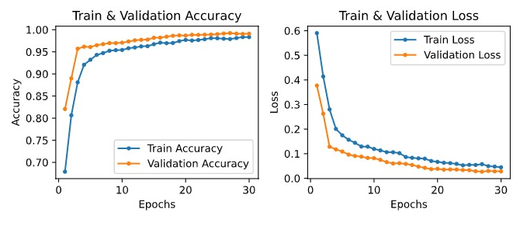
Results
We split our training data into Train and Validation set
Achieves an accuracy of 0.9909 on the validation set
Our proposed method when train on the complete data achieves a score of 0.99537 on 100% test data.

Slide 8
Results
Compared our results with the top-3 teams available on Kaggle public Leaderboard and top-3 teams available on Kaggle private Leaderboard.
Our results outperformed the previous established works.
TEAM NAME | SCORE
Matt Gallagher | 0.98782
Leroy Todd | 0.98589
Dylan Rainwater | 0.98525
Ours | 0.99615
TEAM NAME | SCORE
Leroy Todd | 0.98598
Matt Gallagher | 0.98379
Matthew Legate | 0.96923
Ours | 0.99478
COMPARISON WITH PUBLIC LEADERBOARD
COMPARISON WITH PRIVATE LEADERBOARD

Slide 9
Analysis
This work is done with the ultimate goal of detecting that the provided news article is “Real/Reliable” or “Fake/Unreliable” using the Deep Learning Models and word embeddings.
The Artificial Neural Network plays a very crucial role in analyzing the dataset, extracting features and classification.
The proposed work consist concatenation of two ensemble methods.
The first ensemble model is CNN + Bi-LSTM and the other model is Bi-LSTM + CNN.
We have incorporated different metadata such as Text, title, and author to perform the fake news detection.
Our model has reached the highest accuracy score of 0.99537
In future work we would run our model on larger datasets.
Notes:
The ultimate goal of our work is to detect fake news.We have used Ensembled Deep learning models and word embeddings.
The Neural network is widely used nowadays in NLP related work. Deep learning methods are proving very good at text classification, achieving state-of-the-art results on a suite of standard academic benchmark problems.
The proposed work consist ensembling CNN+Bi-lstm and then Bi-lstm.
It consist of 3 modules .The first module is based on CNN + Bi-LSTM model.The second module, Bi-LSTM + CNN .The third part of our model is to classify an article as fake or not.
We combined the metadata such as TEXT,title and author to perform further processing.
Experimental analysis of data demonstrates that the proposed method achieves higher accuracy than previously-established models.Our model reached the highest accuracy score of 0.9953.
In our future work, we will run our model on large datasets and incorporate multiple metadata in different context to create a complete picture of fake news detection performance.
Below are some references.
Thank you.

Slide 10
References
[1] Verónica Pérez-Rosas, Bennett Kleinberg, Alexandra Lefevre, and Rada Mihalcea.“Automatic detection of fake news”. In:arXiv preprint arXiv:1708.07104 (2017).
[2] J. C. S. Reis, A. Correia, F. Murai, A. Veloso, and F. Benevenuto. “Supervised Learning for Fake News Detection” In:IEEE Intelligent Systems 34.2 (2019), pp. 76–81.DOI 10.1109/MIS.2019.2899143
[3] Natali Ruchansky, Sungyong Seo, and Yan Liu. “Csi: A hybrid deep model for fake news detection”. In: Proceedings of the 2017 ACM on Conference on Information and Knowledge Management 2017, pp. 797–806
[4] Tanik Saikh, Arkadipta De, Asif Ekbal, and Pushpak Bhattacharyya. “A Deep Learning Approach for Automatic Detection of Fake News”. In:arXiv preprint arXiv:2005.04938 (2020)
[5] Kai Shu, Amy Sliva, Suhang Wang, Jiliang Tang, and Huan Liu. “Fake news detection on social media: A data mining perspective”. In: ACM SIGKDD explorations newsletter 19.1 (2017), pp. 22–36
[6] William Wang. “"Liar, Liar Pants on Fire": A New Benchmark Dataset for Fake News Detection”. In: (May 2017).

